Slide 1
Cross-Chain Portable Assets
based on Decentralized Custody

Slide 2
Importance of cross-chain interoperability
Multiple blockchains will exist for the foreseeable future
Heterogeneous chains — tradeoff between various parameters
security, privacy, efficiency, flexibility, platform complexity, etc.
Homogenous chains — breaking the limit of single computer’s power
Cross-Chain Communication is a natural demand
e.g. using BTC in DeFi projects (outside Bitcoin network)

Slide 3
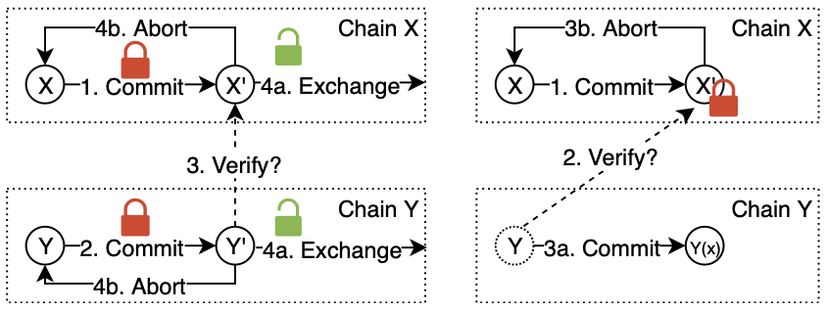
Two kinds of cross-chain communication — exchange vs. one-way transfer

Slide 4
Portable Assets
Goal: using crypto assets outside its home ledger
One-way transfer + backward transfer in the future
Not an atomic swap/exchange
Challenge: how to guarantee the guest chain token is redeemable?
e.g. after converting BTC into xBTC, how to get BTC back?
The home chain token must exist — custody service is necessary

Slide 5






Portable Assets with Custody
Home chain
…
Block0
Block1
Block2
Block3
Block4
1 Coin
1 Coin
coordinator(s)
coordinator(s)
1 xCoin
1 xCoin
Guest chain
…
Block0
Block1
Block2
Block3
Block4

Slide 6
Taxonomy of Portable Assets Custody
 |  | collateralized | uncollateralized
centralized |  | — | wBTC, hBTC, imBTC
decentralized | pre-defined | tBTC | PoA bridge
 | dynamic | XCLAIM, Dogethereum, renBTC | PoS sidechains
 | contract | — | Comprehensive bridge

Slide 7
Drawbacks of existing Solutions
Uncollateralized
trusted coordinators: endorsed by reputation
contract/relay/light client: technically heavy, programability and bandwidth on both chains
Collateralized
heterogeneous collateral
over-collateraliztion: e.g. tBTC 150%, renBTC 300%

Slide 8
Cross-chain Portable BTC
One-way transfer is easy
e.g. BTCRelay is a Bitcoin light client running on Ethereum
The other way around?
Bitcoin is sufficiently dumb to eliminate all kinds of contracts/light clients
external custody coordinators
uncollateralized trusted nodes vs. collateralized nodes

Slide 9
First Glimpse
Why self-custody cannot work?
Homogeneous collateral seems impossible
Who shall hold the collateral of custody coordinators?
Self- or second-layer- custody of collateral?
Then, heterogeneous collateral (comparing to assets under custody) ⇒ over-collateralization to compensate risk of fluctuation ⇒ low efficiency

Slide 10
One Observation
attacker’s power vs. success probability
⇒ secure against bounded attacker
100%
BFT (liveness)
BFT (security)
75%
50%
25%
PoW
0
0
33%
50%
67%
100%

Slide 11
Toy Example
5 custodians, each with collateral of 6 units, 10 units assets under custody
Partitioned into 10 triads, each triad is a custodian group of 3 custodians, controlled as a 2-out-of-3 multisig wallet with (6*5+10)/10=4 units
Adversary power (Corrupted nodes) | 1 | 2 | 3 | 4
Corrupted groups | 0 | 3 | 7 | 10
Controlled assets | 0 | 12 | 28 | 40
Adversary’s collateral | 6 | 12 | 18 | 24
Adversary’s profit | -6 | 0 | 10 | 16

Slide 12
Toy Example - cont’d
5 custodians, each with collateral of 6 units, x units assets under custody
Adversary power (Corrupted nodes) | 1 | 2 | 3 | 4
Corrupted groups | 0 | 3 | 7 | 10
Controlled assets | 0 | 9+0.3x | 21+0.7x | 30+x
Adversary’s collateral | 6 | 12 | 18 | 24
Adversary’s profit | -6 | -3+0.3x | 3+0.7x | 6+x
Allowed assets under custody | ∞ | 10 | -30/7 | -6
Efficiency factor (allowed assets/collateral) | ∞ | 1/3 | -1/7 | -1/5
Higher efficiency factor ⇔ lower collateral rate

Slide 13
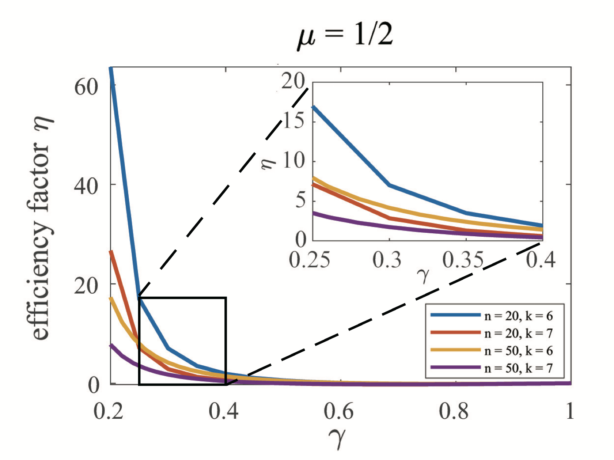
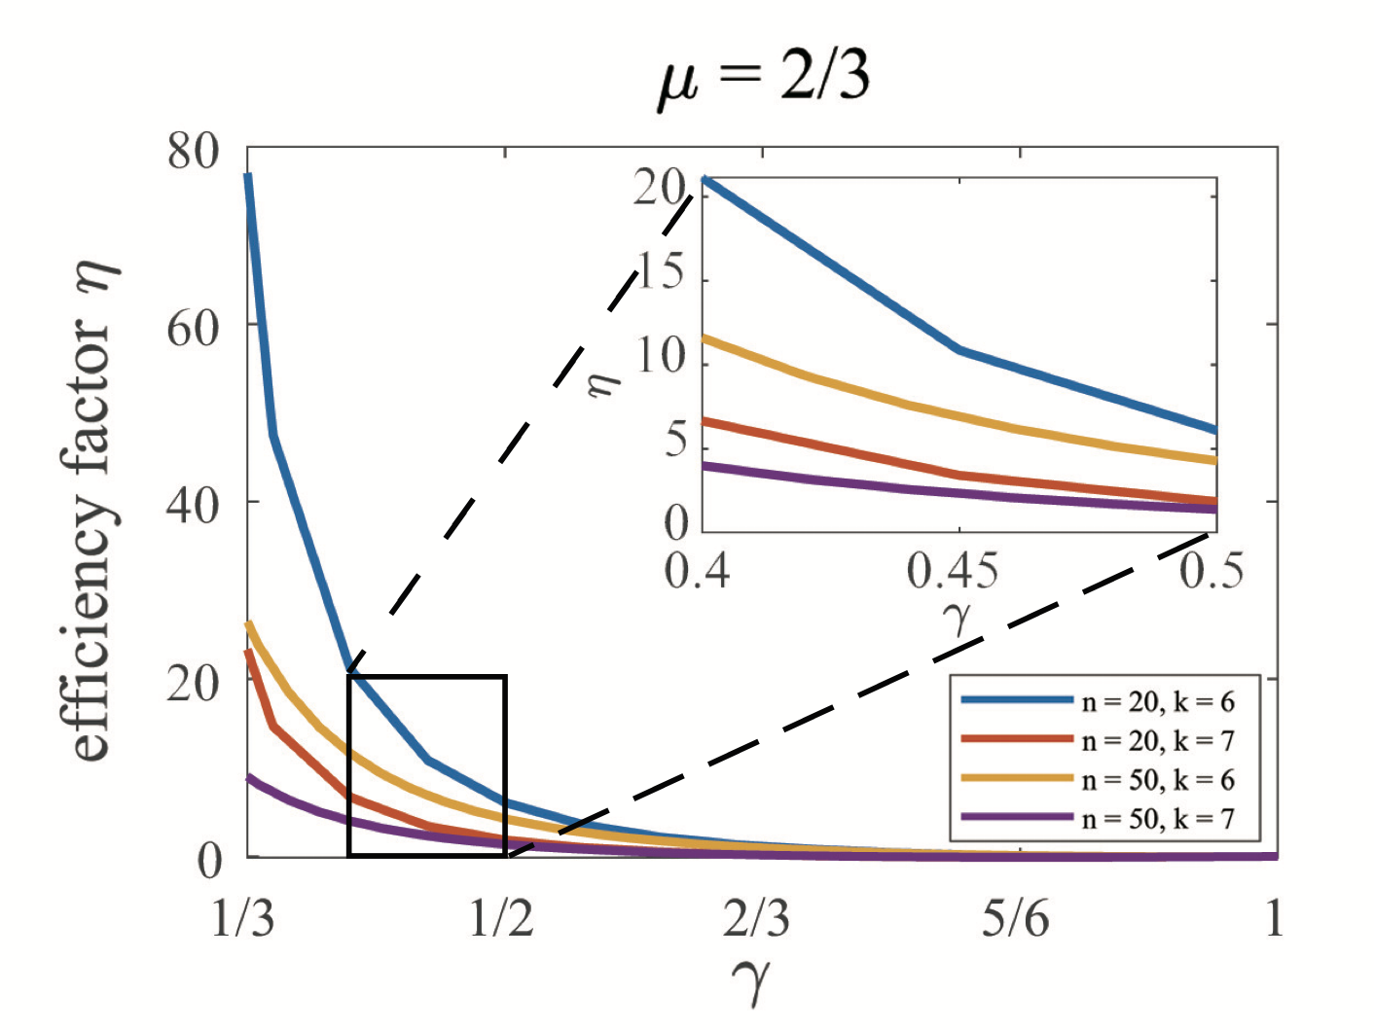
Towards better efficiency
Construction 1: For n participants, consider all size-k subsets as custodian groups.
Adversary power γ
Group authentication threshold μ
E.g. n=20, k=6, μ =2/3 ⇒ η = 21.1486 when γ=0.4
total number of custodian groups = 38760

Slide 14
Towards better efficiency cont’d
k^{d} custodian groups in total
Construction 2: For n=k² participants, consider a degree-d polynomial design:
every participant denoted by (x,y) ∈ Zk
every custodian group consists of k participants specified by a degree-d monic polynomial p as {(0,p(0)), (1,p(1)), …, (k-1,p(k-1))}
the interaction of any two distinct groups ≤ d
every participant belongs to k^{d-1} custodian groups

Slide 15
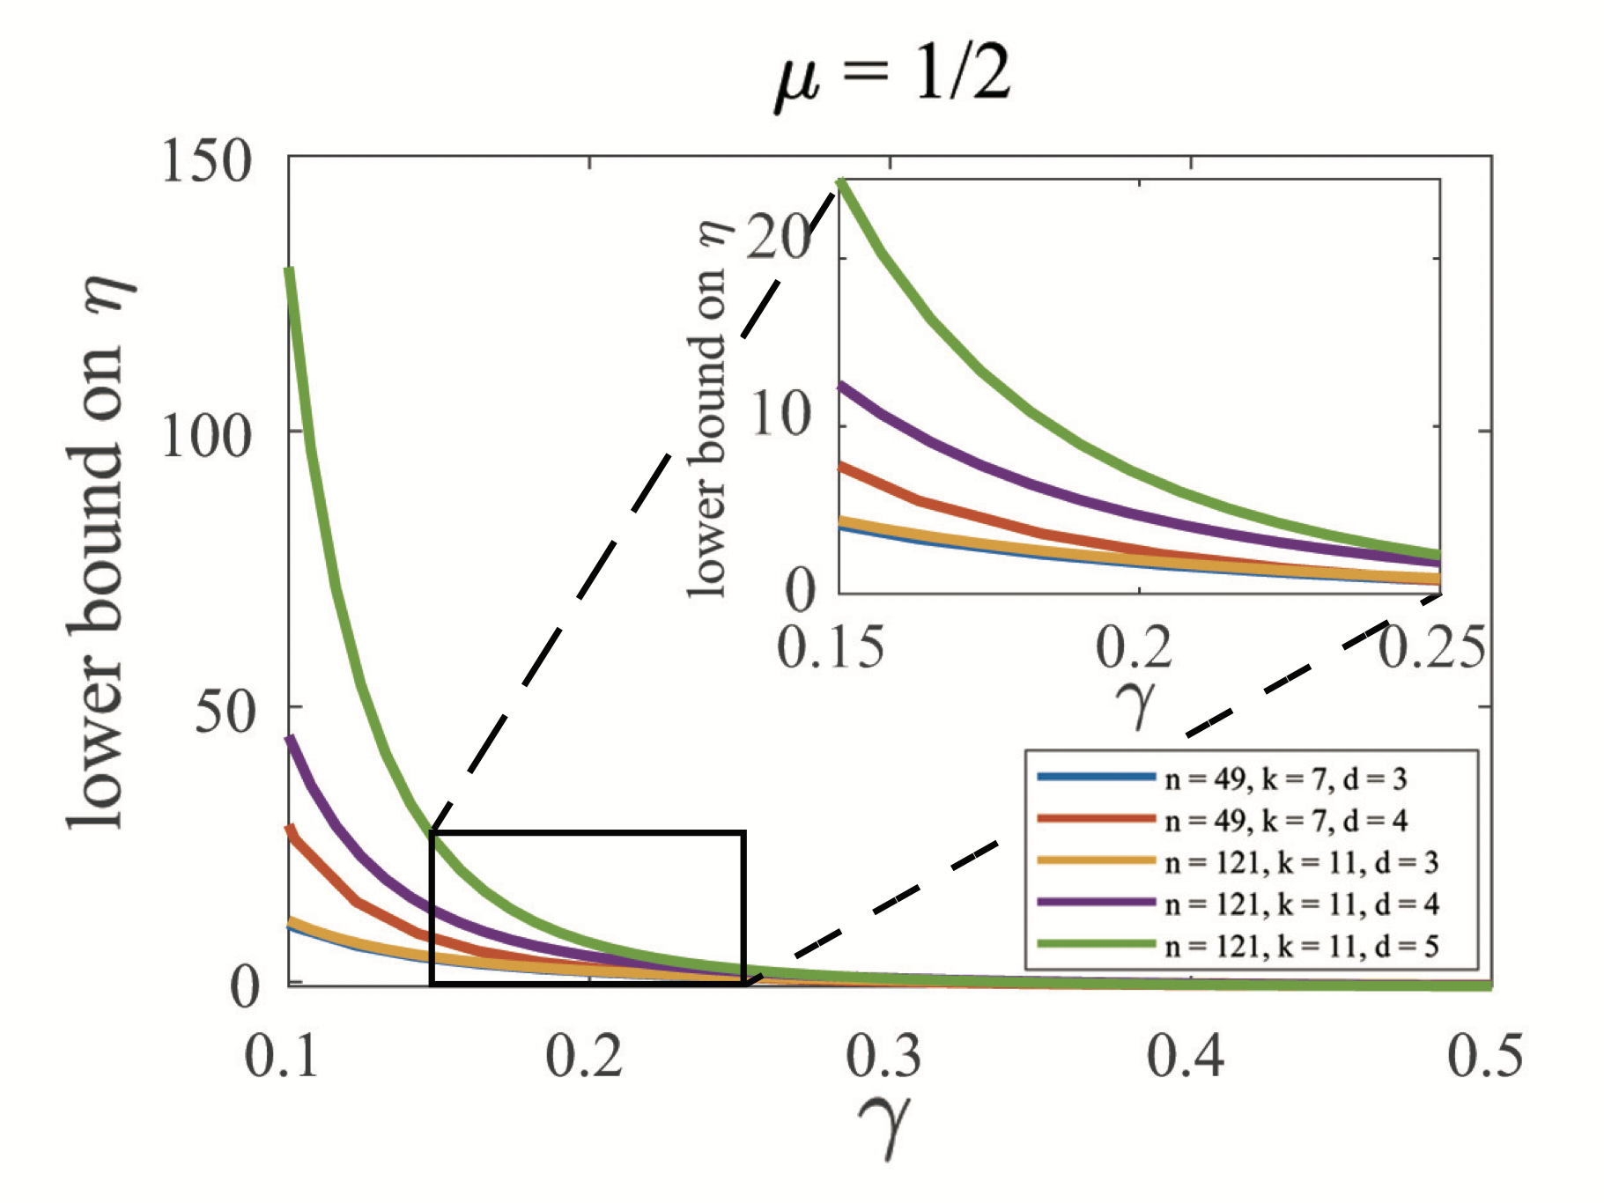
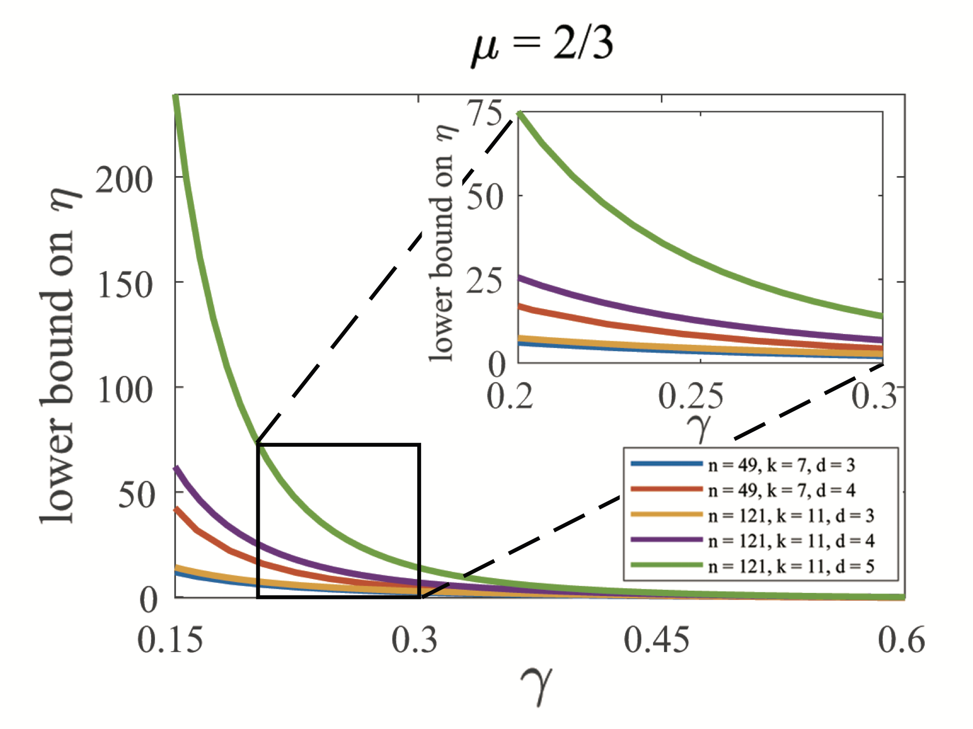
Towards better efficiency cont’d
k^{d} custodian groups in total
Construction 2: For n=k² participants, consider a degree-d polynomial design:
every participant denoted by (x,y) ∈ Zk
every custodian group consists of k participants specified by a degree-d monic polynomial p as {(0,p(0)), (1,p(1)), …, (k-1,p(k-1))}
the interaction of any two distinct groups ≤ d
every participant belongs to k^{d-1} custodian groups

Slide 16
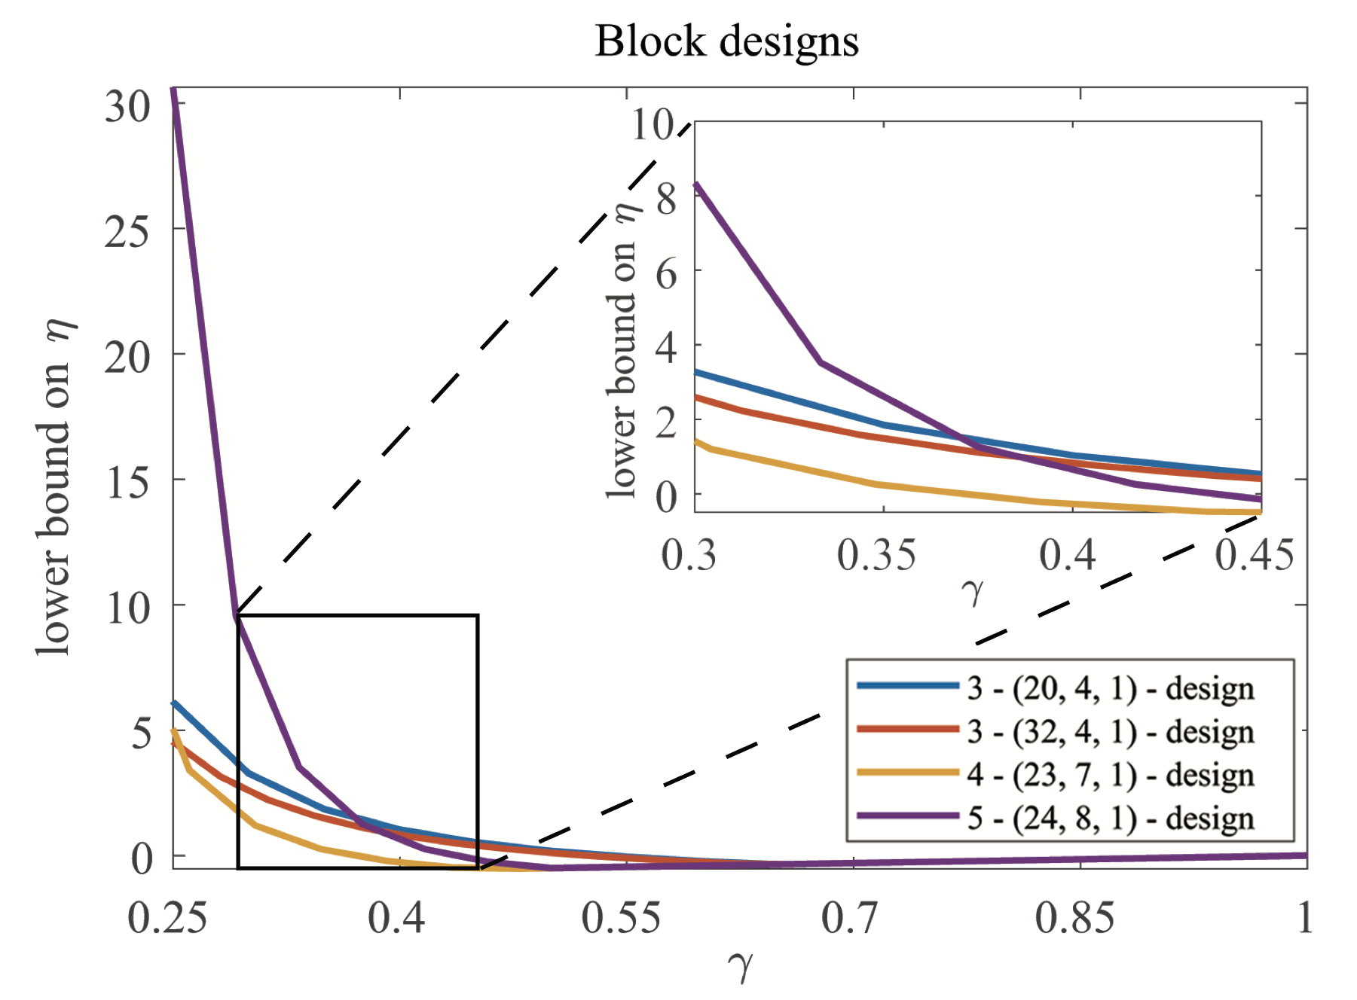
Towards better Efficiency
Construction 3: For n participants, consider r-(n,k,λ) block designs as custodian groups.
Each group consists of k participants, where every r-element subset appears in exactly λ groups
5-(24,8,1) design with μ =2/3 ⇒ η ≥30.6250 when γ=0.25
total number of custodian groups = 759

Slide 17
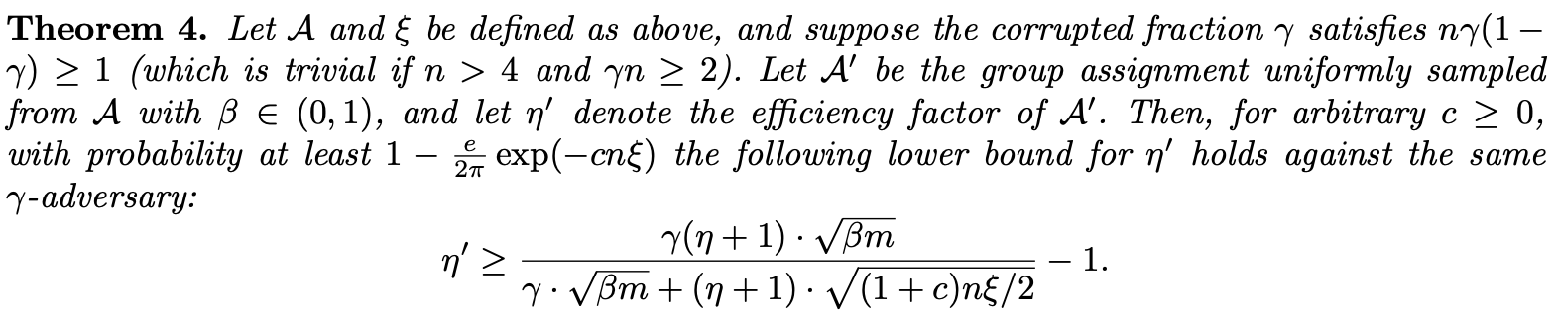
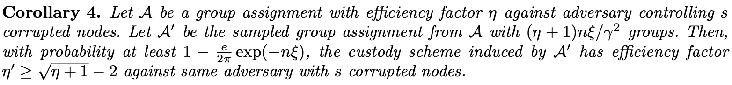
Compact Construction
Better efficiency factor usually requires a lot of custodian groups
May be difficult to manage
How to reduce the number of custodian groups?
Random sampling!

Slide 18
Future work
Better custodian group assignment scheme:
large efficiency factor: less collateral to safely hold more assets
reasonable complexity: less and smaller groups for more coordinators
Scheduling methods:
load-balancing among custodian groups
dynamic coordinators
Incentive for custodian coordinators: commission fee + tax

Slide 19
Reference
Zhaohua Chen, Guang Yang. Decentralized Custody Scheme with Game-Theoretic Security. https://arxiv.org/abs/2008.10895
Vitalik Buterin. Chain Interoperability. https://www.r3.com/reports/chain-interoperability/
Alexei Zamyatin, et’al. SoK: Communication Across Distributed Ledgers. ePrint 2019-1128

Slide 20
Thanks!

